Slide 1
“By the User, For the User, With the Learning System”:
Learning From User Interactions
Karthik Raman
March 27, 2014
Joint work with Thorsten Joachims,
Pannaga Shivaswamy, Tobias Schnabel

Slide 2
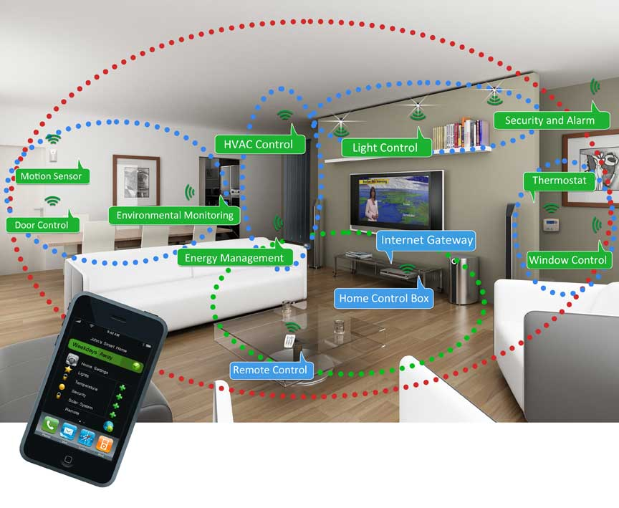

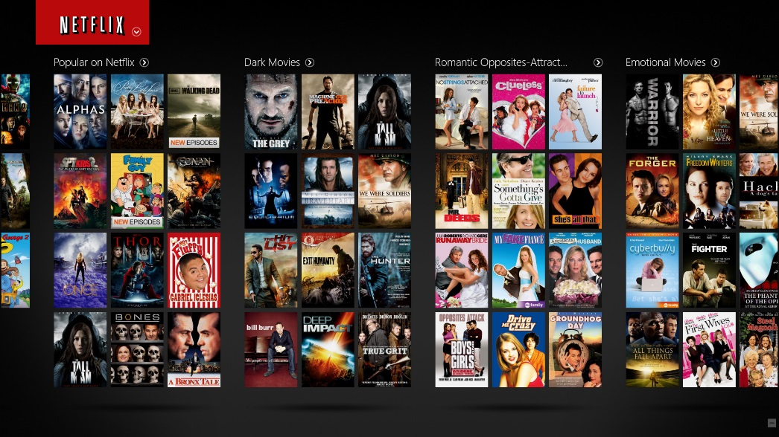
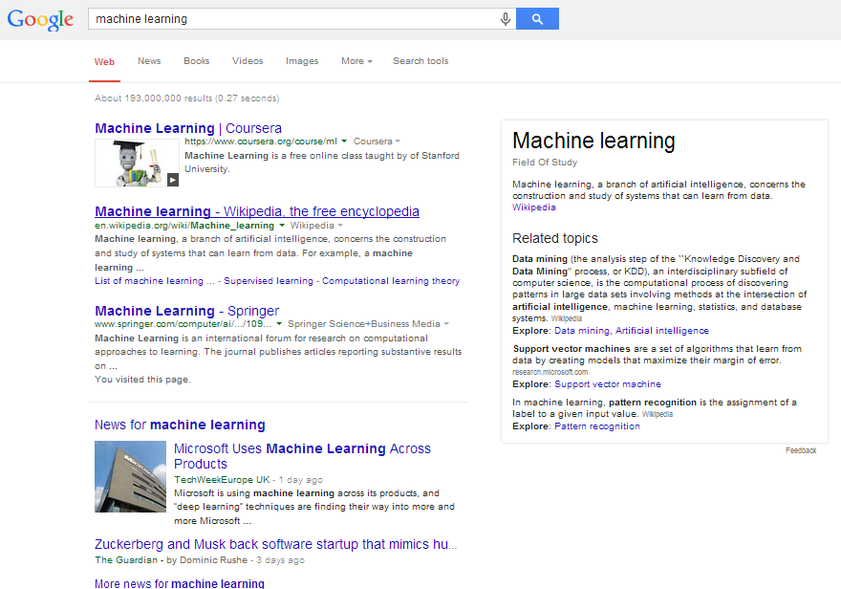
Age Of the WEB & DATA
Learning is important for today’s Information Systems:
  Search Engines
  Recommendation Systems
  Social Networks, News sites
  Smart Homes, Robots ….
Difficult to collect expert-labels for learning:
  Instead: Learn from the user (interactions).
  User feedback is timely, plentiful and easy to get.
  Reflects user’s – not experts’ – preferences

Slide 3
Interactive Learning With Users
Takes Action (e.g., Present ranking)
SYSTEM
(e.g., Search Engine)
USER(s)
Interacts and Provides Feedback
(e.g., User clicks)
Users and system jointly work on the task.
  System is not a passive observer of user.
Need to develop learning algorithms in conjunction with plausible models of user behavior.

Slide 4
Agenda For This Talk
Designing algorithms, for interactive learning with users, that are applicable in practice and have theoretical guarantees.
Outline:
  Handling weak, noisy and biased user feedback.
  Modeling dependence across items/documents (Intrinsic Diversity).
  Dealing with diverse user populations (Extrinsic Diversity).

Slide 5
Agenda For This Talk
Designing algorithms, for interactive learning with users, that are applicable in practice and have theoretical guarantees.
Outline:
  Handling weak, noisy and biased user feedback. [RJSS ICML’13]
  Modeling dependence across items/documents (Intrinsic Diversity).
  Dealing with diverse user populations (Extrinsic Diversity).

Slide 6
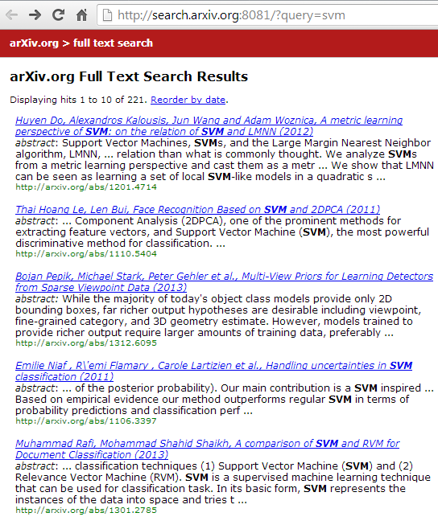
User Feedback
BIASED: Has been shown to be better than docs above, but cannot say anything about docs below.
Higher the document, the more clicks it gets.
WEAK: Even if first among clicked documents cannot say it is best.
Click!
NOISE: May receive some clicks even if irrelevant.

Slide 7
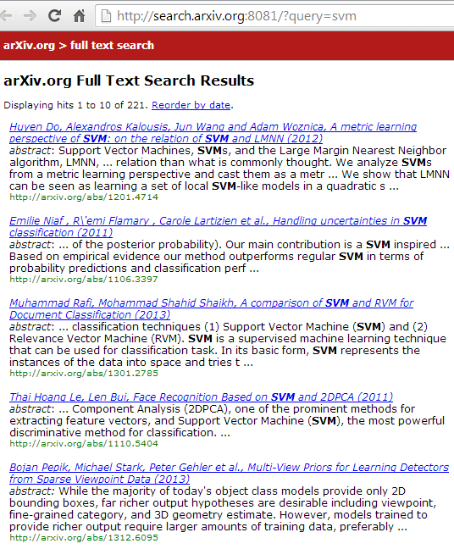
Implicit Feedback From User
Presented Ranking
Improved Ranking
Click!
Click!
Click!

Slide 8
Coactive Learning Model
Present Object y_{t} (e.g., Ranking)
Context x_{t}
e.g., Query
SYSTEM
(e.g., Search Engine)
USER
Receive Improved Object
User has utility U(x_{t}, y_{t}).
COACTIVE: U(x_{t}, y’_{t}) ≥_{α} U(x_{t}, y_{t}).
Feedback assumed by other online learning models:
FULL INFORMATION: U(x_{t}, y¹), U(x_{t}, y²) . . .
BANDIT: U(x_{t}, y_{t}).
OPTIMAL : y*_{t} = argmax_{y} U(x_{t},y)

Slide 9
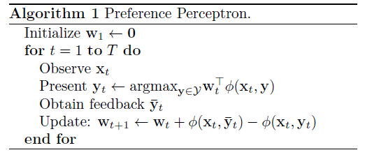
Preference Perceptron
Initialize weight vector w.
Get context x and present best y (as per current w).
Get feedback and construct (move-to-top) feedback.
Perceptron update to w :
  w += Φ( Feedback) - Φ( Presented)

Slide 10
Theoretical Analysis
Analyze the algorithm’s regret i.e., the total sub-optimality
where y*_{t} is the optimal prediction.
Characterize feedback as α-Informative:
Not an assumption: Can characterize all user feedback
  α indicates the quality of feedback, ξ_{t} is the slack variable (i.e. how much lower is received feedback than α quality).

Slide 11
Regret Bound For Preference Perceptron
For any α and w* s.t.:
the algorithm has regret:
Changes gracefully with α.
Independent of Number of Dimensions
Converges as √T
(Same rate as optimal feedback convergence)
Noise component

Slide 12
How Does It Do in Practice?
Performed user study on full-text search on arxiv.org
  Goal: Learning a ranking function
Win Ratio: Interleaved comparison with (non-learning) baseline.
Higher ratio is better
(1 indicates similar perf.)
Feedback received has large slack values (for any reasonably large α)
Preference Perceptron performs poorly and is not stable.

Slide 13
Illustrative Example
T
w
1
1
-1
d₁
Only relevant doc.
d₂
Feature Values
1
0
......
d₁
d_{2…N}
0
1
d_{N}
Say user is imperfect judge of relevance: 20% error rate.

Slide 14
Illustrative Example
T
w
209
-0.1
0.1
10
218
79
17
1
4
2
3
0.2
-0.2
0.4
0.6
1
-0.6
-1
0.2
-0.2
-0.4
d_{N}
d₁
For N=10, Averaged over 1000 runs.
d₂
Method | Avg. Rank of Rel Doc
Preference Perceptron | 9.36
Averaged Preference Perceptron | 9.37
3PR (Our Method) | 2.08
Feature Values
1
0
......
d₁
d_{2…N}
0
1
d₁
d_{N}
Say user is imperfect judge of relevance: 20% error rate.
Algorithm oscillates!!
Averaging or regularization cannot help either.

Slide 15
Key Idea: Perturbation
T
w
Feature Values
6
2
8
1.4
1.8
1.4
1
-1
-1.4
-1.8
-1.4
d₂
d₁
1
0
d₁
d₁
What if we randomly swap adjacent pairs?
  E.g. The first 2 results
Update only when lower doc. of pair clicked.
d₂
0
1
d_{2…N}
......
d_{N}
Algorithm is stable!!
Swapping reinforces correct w at small cost of presenting sub-optimal object.

Slide 16
Perturbed Preference Perceptron for Ranking(3PR)
Initialize weight vector w.
Get context x and find best y (as per current w).
Perturb y and present slightly different solution y’
  Swap adjacent pairs with probability p_{t}.
Observe user feedback.
  Construct pairwise feedback.
Perceptron update to w :
  w += Φ( Feedback) - Φ( Presented)
Can use constant p_{t} = 0.5 or dynamically determine it.

Slide 17
3PR Regret Bound
  Under the α-Informative feedback characterization, can show regret bound:
  Better ξ_{t} values (lower noise) than preference perceptron at cost of a vanishing term.

Slide 18
Does This Work?
Running for more than a year
  No manual intervention

Slide 19
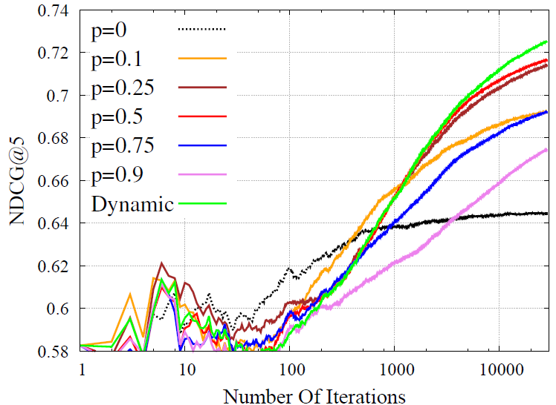
Effect of Swap Probability
Robust to change in swap.
Even some swapping helps.
Dynamic strategy performs best.

Slide 20
Agenda For This Talk
Designing algorithms, for interactive learning with users, that are applicable in practice and have theoretical guarantees.
Outline:
  Handling weak, noisy and biased user feedback.
  Modeling dependence across items/documents (Intrinsic Diversity).
    [RSJ KDD’12]
  Dealing with diverse user populations (Extrinsic Diversity).

Slide 21

Intrinsically Diverse User
Economy
Sports
Technology

Slide 22
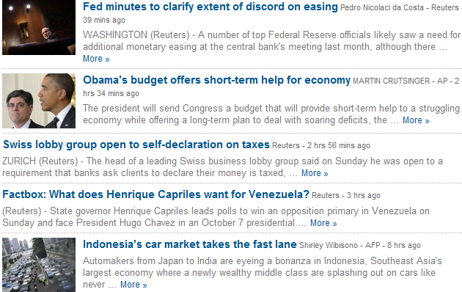
Challenge: Redundancy
Economy
Sports
Tech
Nothing about sports or tech.
Lack of diversity leads to some interests of the user being ignored.

Slide 23
Previous Work
Extrinsic Diversity:
  Non-learning approaches:
    MMR (Carbonell et al ‘98), Less is More (Chen et al. ‘06)
  Learning approaches: SVM-Div(Yue, Joachims ‘08)
    Require relevance labels for all user-document pairs
  Ranked Bandits (Radlinski et al. ICML’08):
    Use online learning: Array of (decoupled) Multi-Armed bandits.
    Learns very slowly in practice.
  Slivkins et al. JMLR ‘13
    Couples arms together.
    Does not generalize across queries.
    Hard coded-notion of diversity. Cannot be adjusted.
Yue et. al. NIPS’12
  Generalizes across queries.
  Requires cardinal utilities.

Slide 24
Modeling Dependencies Using Submodular functions
KEY: For a given query and word, the marginal benefit of additional documents diminishes.
E.g.: Coverage Function
Use greedy algorithm:
  At each iteration:
    Choose Document that Maximizes Marginal Benefit
Simple and efficient
Constant Factor approximation
D₄
D₁
D₃
D₂

Slide 25
Predicting Diverse Rankings
Ranking | _{economy} | _{usa} | _{soccer} | _{technology}
d₁ | economy:3, usa:4, finance:2 ..
d₂ | usa:3, soccer:2,world cup:2..
d₃ | usa:4, politics:3, economy:2 …
d₄ | gadgets:2, technology:4, ipod:2..
Word | Weight
economy | 1.5
usa | 1.2
soccer | 1.6
technology | 1.1
Diversity-Seeking User:

Slide 26
Predicting Diverse Rankings: Max(x)
Ranking | _{economy} | _{usa} | _{soccer} | _{technology}
d₁ | economy:3, usa:4, finance:2 ..
d₂ | usa:3, soccer:2,world cup:2..
d₃ | usa:4, politics:3, economy:2 …
d₄ | gadgets:2, technology:4, ipod:2..
Word | Weight
economy | 1.5
usa | 1.2
soccer | 1.6
technology | 1.5
Doc. | _{Marginal Benefit}
d₁ | _{9.3}
d₂ | _{6.8}
d₃ | _{7.8}
d₄ | _{6.0}

Slide 27
Predicting Diverse Rankings
Ranking | _{economy} | _{usa} | _{soccer} | _{technology}
d₁ | ₃ | ₄ | ₀ | ₀
MAX of Column | ₃ | ₄ | ₀ | ₀
d₁ | economy:3, usa:4, finance:2 ..
d₂ | usa:3, soccer:2,world cup:2..
d₃ | usa:4, politics:3, economy:2 …
d₄ | gadgets:2, technology:4, ipod:2..
Word | Weight
economy | 1.5
usa | 1.2
soccer | 1.6
technology | 1.5
Doc. | _{Marginal Benefit}
d₁ | _{9.3}
d₂ | _{6.8}
d₃ | _{7.8}
d₄ | _{6.0}

Slide 28
Predicting Diverse Rankings
Ranking | _{economy} | _{usa} | _{soccer} | _{technology}
d₁ | ₃ | ₄ | ₀ | ₀
MAX of Column | ₃ | ₄ | ₀ | ₀
d₁ | economy:3, usa:4, finance:2 ..
d₂ | usa:3, soccer:2,world cup:2..
d₃ | usa:4, politics:3, economy:2 …
d₄ | gadgets:2, technology:4, ipod:2..
Word | Weight
economy | 1.5
usa | 1.2
soccer | 1.6
technology | 1.5
Doc. | _{Marginal Benefit}
d₁ | _{0.0}
d₂ | _{3.2}
d₃ | _{0.0}
d₄ | _{6.0}

Slide 29
Predicting Diverse Rankings
Ranking | _{economy} | _{usa} | _{soccer} | _{technology}
d₁ | ₃ | ₄ | ₀ | ₀
d₄ | ₀ | ₀ | ₀ | ₄
MAX of Column | ₃ | ₄ | ₀ | ₄
d₁ | economy:3, usa:4, finance:2 ..
d₂ | usa:3, soccer:2,world cup:2..
d₃ | usa:4, politics:3, economy:2 …
d₄ | gadgets:2, technology:4, ipod:2..
Word | Weight
economy | 1.5
usa | 1.2
soccer | 1.6
technology | 1.5
Doc. | _{Marginal Benefit}
d₁ | _{0.0}
d₂ | _{3.2}
d₃ | _{0.0}
d₄ | _{6.0}

Slide 30
Predicting Diverse Rankings
Ranking | _{economy} | _{usa} | _{soccer} | _{technology}
d₁ | ₃ | ₄ | ₀ | ₀
d₄ | ₀ | ₀ | ₀ | ₄
d₂ | ₀ | ₃ | ₂ | ₄
MAX of Column | ₃ | ₄ | ₂ | ₄
d₁ | economy:3, usa:4, finance:2 ..
d₂ | usa:3, soccer:2,world cup:2..
d₃ | usa:4, politics:3, economy:2 …
d₄ | gadgets:2, technology:4, ipod:2..
Word | Weight
economy | 1.5
usa | 1.2
soccer | 1.6
technology | 1.5
Can also use other submodular functions which are less stringent for penalizing redundancy
e.g. log(), sqrt() ..
Doc. | _{Marginal Benefit}
d₁ | _{0.0}
d₂ | _{3.2}
d₃ | _{0.0}
d₄ | _{0.0}

Slide 31


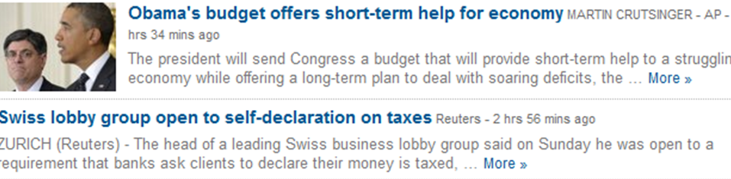

Diversifying Perceptron
Presented Ranking (y)
Improved Ranking (y’)
Click!
Initialize weight vector w.
Get context x and find best y (as per current w):
  Using greedy algorithm to make prediction.
Observe user implicit feedback and construct feedback object.
Perceptron update to w :
  w += Φ( Feedback) - Φ( Presented)
5. Clip weights to ensure non-negativity.
Click!
Click!

Slide 32
Diversifying Perceptron
Under same feedback characterization, can bound regret w.r.t. optimal solution:
Term due to greedy approximation

Slide 33
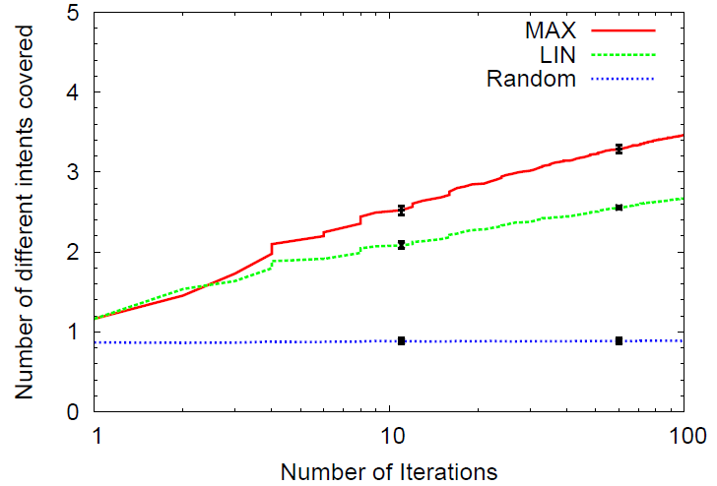
Can we Learn to Diversify?
Submodularity helps cover more intents.

Slide 34
Other results
Robust and efficient:
  Robust to noise and weakly informative feedback.
  Robust to model misspecification.
Achieves the performance of supervised learning:
  Despite not being told the true labels and receiving only partial information.

Slide 35
Agenda For This Talk
Designing algorithms, for interactive learning with users, that are applicable in practice and have theoretical guarantees.
Outline:
  Handling weak, noisy and biased user feedback.
  Modeling dependence across items/documents (Intrinsic Diversity).
  Dealing with diverse user populations (Extrinsic Diversity). [RJ ECML’13]

Slide 36
Example: Web Search

Slide 37
Example: Web Search

Slide 38
Example: Web Search

Slide 39
Example: Web Search

Slide 40
Example: Web Search

Slide 41
Example: Web Search

Slide 42
Example: Web Search

Slide 43
Example: Web Search

Slide 44
Motivating Problem
Intrinsic Diversity
Diversity across aspects/user interests.
Specific to single user.
  Diversity reflected in user feedback.
Need to balance coverage across aspects.
Extrinsic Diversity
Diversity across different intents.
  E.g. Query “svm”, “jaguar”
Different users with different intents.
Satisfy all users to best extent possible.
More generally, how do you satisfy a crowd of diverse individuals who act egoistically?

Slide 45
Previous Work
Non-learning approaches:
  MMR (Carbonell et al ‘98), Less is More (Chen et al. ‘06)
Learning approaches: SVM-Div(Yue, Joachims ‘08)
  Require relevance labels for all user-document pairs
Ranked Bandits (Radlinski et al. ICML’08):
  Use online learning: Array of (decoupled) Multi-Armed bandits.
  Learns very slowly in practice.
Slivkins et al. JMLR ‘13
  Couples arms together.
  Does not generalize across queries.
  Hard coded-notion of diversity. Cannot be adjusted.
Intrinsic Diversity:
  Yue et. al. NIPS’12
  Generalizes across queries.
  Requires cardinal utilities.

Slide 46

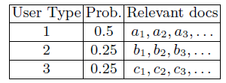
Social Utility & Egoistic Feedback
N different user types:
  Each has probability/importance p_{i}.
  Associated user utility U_{i}.
  Users act selfishly as per their own utility.
Goal: Maximize social utility:
Let U_{i} = √ # of Rel. in Top-4
Ranking {a₁, a₂, a₃, a₄} best for type 1 but E[U]=1
Ranking {a₁, b₁, c₁, a₂} best socially with E[U] =1.21
Selfish feedback can lower social utility.

Slide 47
Social Perceptron For Ranking
Initialize weight vector w.
Get context x and find best y (per current w):
  Using greedy algorithm to make prediction.
Randomly swap adjacent pairs in y.
Observe user implicit feedback and construct pairwise feedback object.
Perceptron update: w += Φ( Feedback) - Φ( Presented)
Clip w and ensure non-negative weights.
Broadly, the combination of ideas works.
Can also provide algorithm for optimizing for set-based utility functions.

Slide 48

Social Perceptron Regret
Regret bounds under slightly different feedback characterization:

Slide 49
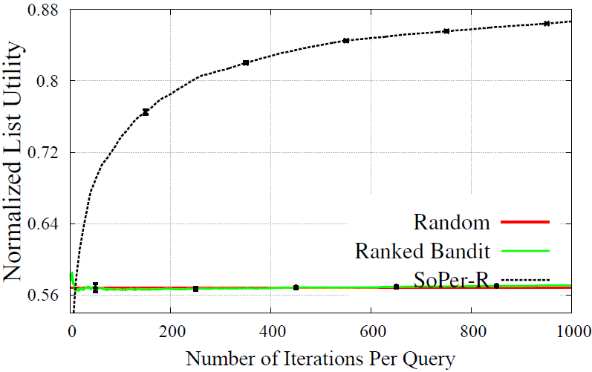
Experimental Results
Improved learning (faster and better) for single-query diversification.

Slide 50
Experimental Results
StructPerc is (rough) skyline: Uses optimal for training
First method to learn cross-query diversity from implicit feedback.
Robust and efficient.

Slide 51
Summary
Designing algorithms for interactive learning with users that work well in practice and have theoretical guarantees.
Studied how to:
  Work with noisy, biased feedback.
  Modeling item dependencies.
  Resolving conflicting preferences across diverse populations.
Robustness to noise, biases and model misspecification.
Efficient algorithms that learn fast.
End-to-end live evaluation.
Analyze algorithm performance in terms of regret.

Slide 52
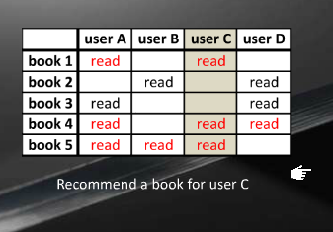
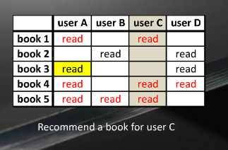
Future Directions: Recommender Systems
Collaborative filtering/matrix factorization.
Challenges:
  Learn from observed user actions: Biased preferences vs. cardinal utilities.
  Bilinear utility models for leveraging feedback to help other users as well.

Slide 53
Future Directions: Reusing past data
Suppose we have historical logs of user interactions.
  Can we learn (and evaluate) using this data?
Bridges gap to supervised learning.
  First step towards benchmarks.
  More data => Better learning!!

Slide 54
Future Directions: Education and Games
MOOCs & Education Games have changed education.
Lot of student interactions in different phases:
  Peer Grading
  Lectures and Material
  Forum participation and Question-Answering

Slide 55
Thank you!
Questions?

Slide 56
References
A. Slivkins, F. Radlinski, and S. Gollapudi. Ranked bandits in metric spaces: learning optimally diverse rankings over large document collections. JMLR, 2013.
Y. Yue and C. Guestrin. Linear submodular bandits and their application to diversied retrieval. NIPS, 2012.
F. Radlinski, R. Kleinberg, and T. Joachims. Learning diverse rankings with multi-armed bandits. ICML, 2008.
P. Shivaswamy and T. Joachims. Online structured prediction via coactive learning. ICML, 2012.

Slide 57
References (Contd.)
T. Joachims, L. Granka, Bing Pan, H. Hembrooke, F. Radlinski, G. Gay. Evaluating the Accuracy of Implicit Feedback from Clicks and Query Reformulations in Web Search. ACM TOIS, 2007.
Y. Yue and T. Joachims. Predicting Diverse Subsets Using Structural SVMs. ICML, 2008.
J. Carbonell and J. Goldstein. The use of MMR, diversity-based reranking for reordering documents and reproducing summaries. SIGIR, 1998.
H. Chen and D. Karger. Less is more: Probabilistic models for retrieving fewer relevant documents. SIGIR, 2006.

Slide 58
References (Contd.)
Karthik Raman, Pannaga Shivaswamy and Thorsten Joachims. Online Learning to Diversify from Implicit Feedback. KDD 2012
Karthik Raman, Thorsten Joachims, Pannaga Shivaswamy and Tobias Schabel. Stable Coactive Learning via Perturbation. ICML 2013
Karthik Raman, Thorsten Joachims. Learning Socially Optimal Information Systems from Egoistic Users. ECML 2013

Slide 59
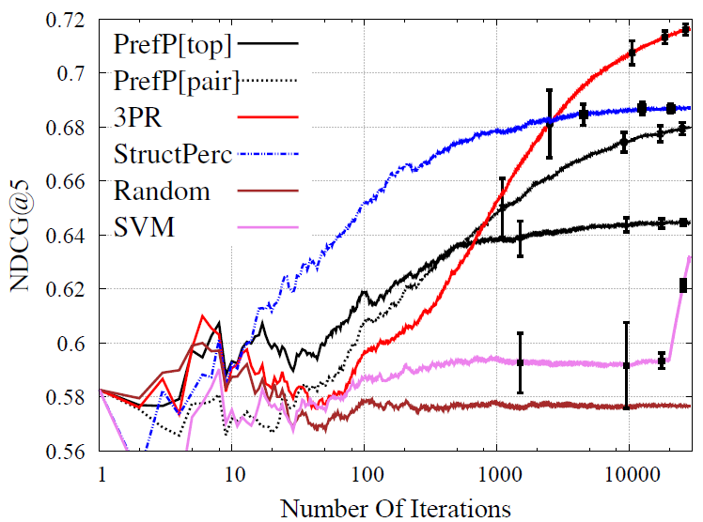
Benchmark Results
On Yahoo! search dataset.
PrefP[pair] is 3PR w/o perturbation
Performs well.

Slide 60
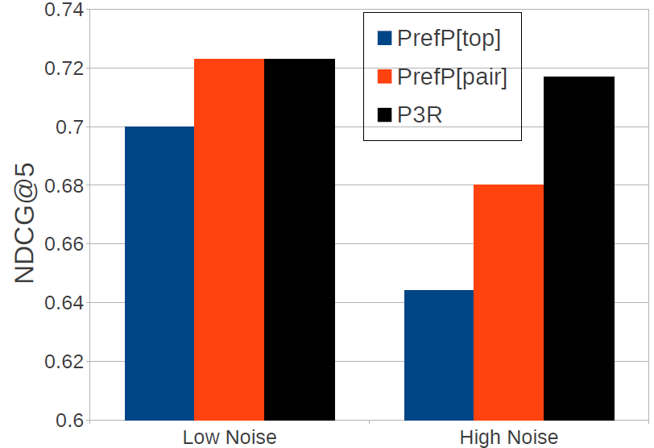
Effect of Noise
Robust to noise:
  Minimal change in performance
Other algorithms: more sensitive.

Slide 61
Effect Of Perturbation
Perturbation only has a small effect even for fixed p (p=0.5)

Slide 62
Stability on ArXiv
Few common results in the top 10 after 100 learning iterations.

Slide 63
General Proof Technique
Bound the 2-norm of the weight vector (w_{T}).
Relate the inner product of w* and w_{T} to regret:
  Use the feedback characterization

Slide 64
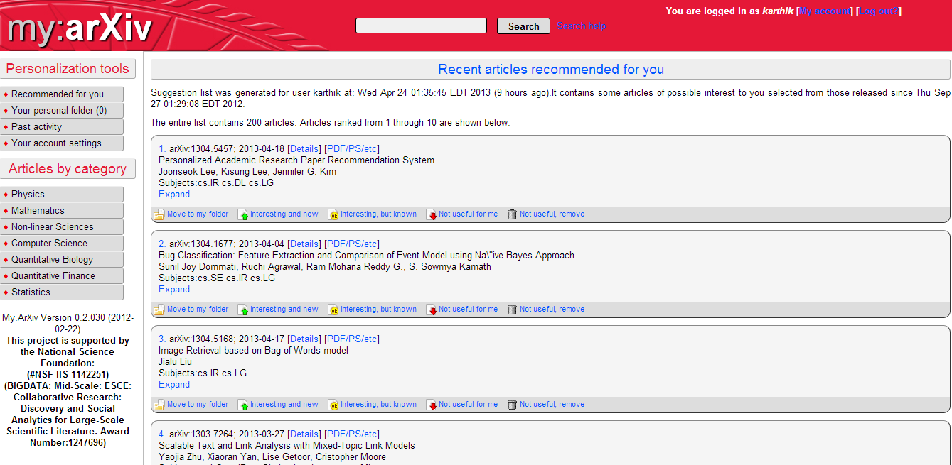
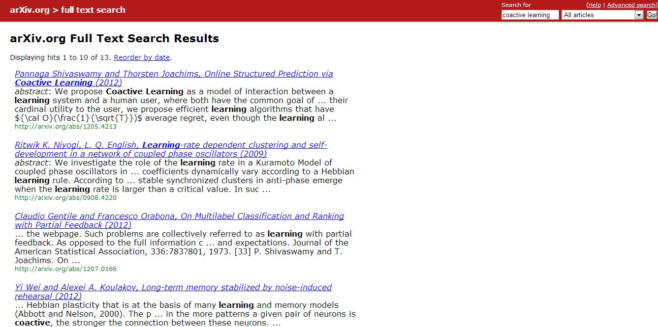
Coactive Learning in real systems

Slide 65
Feature Aggregation
Ranking | _{economy} | _{usa} | _{soccer} | _{technology}
d₁ | ₃ | ₄ | ₀ | ₀
d₄ | ₀ | ₀ | ₀ | ₄
d₂ | ₀ | ₃ | ₂ | ₄
MAX of Column | ₃ | ₄ | ₂ | ₄
SQRT of Col. sum | _{1.73} | _{2.65} | _{1.41} | _{2.82}
Column sum | ₃ | ₇ | ₂ | ₈
d₁ | economy:3, usa:4, finance:2 ..
d₂ | usa:3, soccer:2,world cup:2..
d₃ | usa:4, politics:3, economy:2 …
d₄ | gadgets:2, technology:4, ipod:2..
Word | MAX Weight | SQRT | COLSUM
economy | 1.5 | 3.7 | 0.5
usa | 1.2 | 4.8 | 2.3
soccer | 1.6 | 3.2 | 4.1
technology | 1.5 | 4.9 | 0.4
Can combine different submodular functions.

Slide 66
General Submodular Utility (CIKM’11)
Given ranking θ = (d₁, d₂,…. d_{k}) and concave function g

